Slide 1
A Helping Hand
This is a guide to Project No.5 – “A Helping Hand” carried out by the team “TechieDivas”

Slide 2
Home Page
This project is a web application.
To run the project, run “Frontend/home.html” and Get Started!

Slide 3


Slide 4
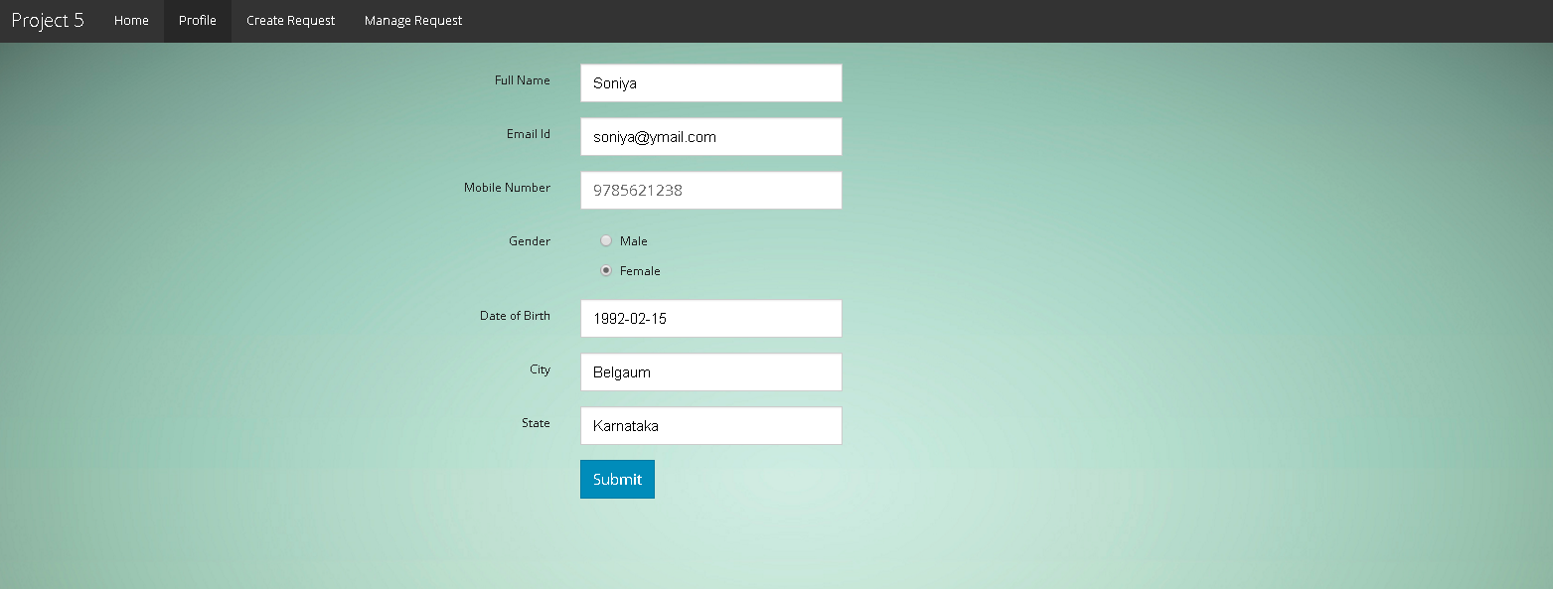
Profile Page
The user has to create a profile in the profile page.

Slide 5
Create Request Page
It consists of two tabs, namely – Contact details and Request details.
The contact details page is provided keeping in mind that the user can create a request for somebody else. For example, a village panchayat creating a request on behalf of a villager.
It has a auto fill option to fill the details from the user’s profile.
The request details tab has option to seek/offer help.

Slide 6
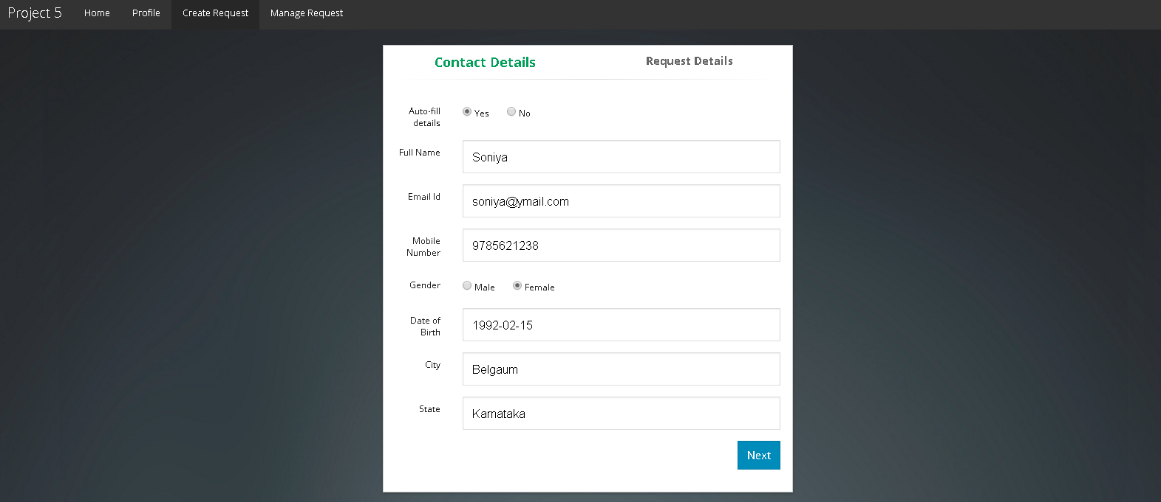
Contact details tab

Slide 7
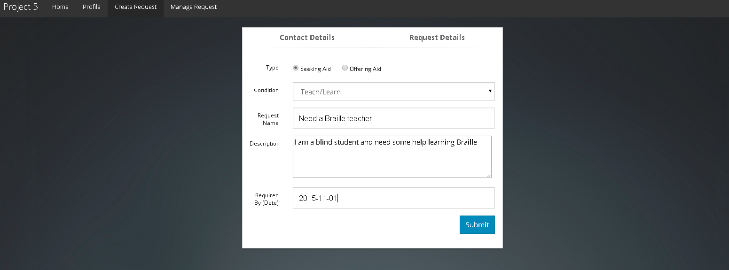
Request details tab - Seeker

Slide 8
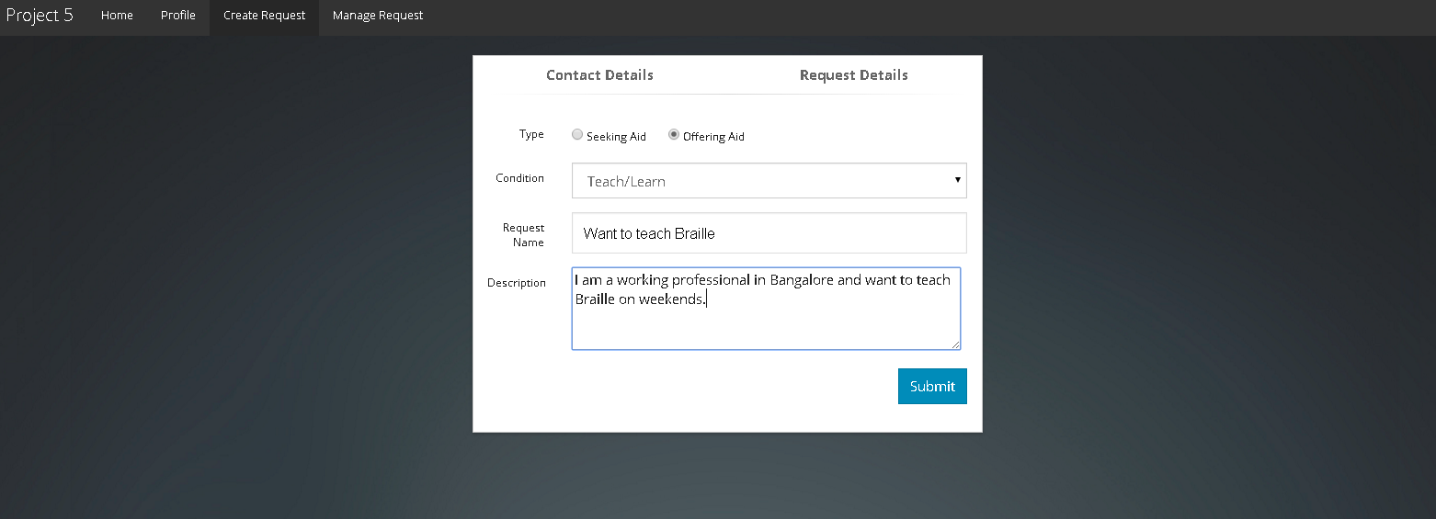
Request details tab - Volunteer

Slide 9
Manage Requests
This page lists all the requests raised by the seeker.
It has options to
Check for a volunteer
Delete a request
View details of a volunteer

Slide 10
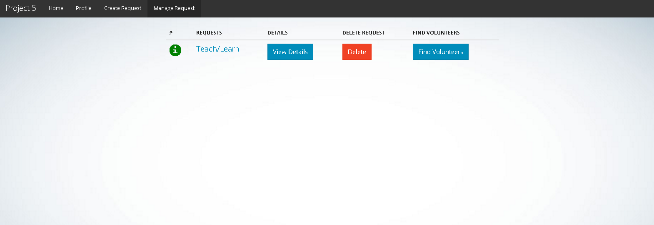
Manage Request Page

Slide 11
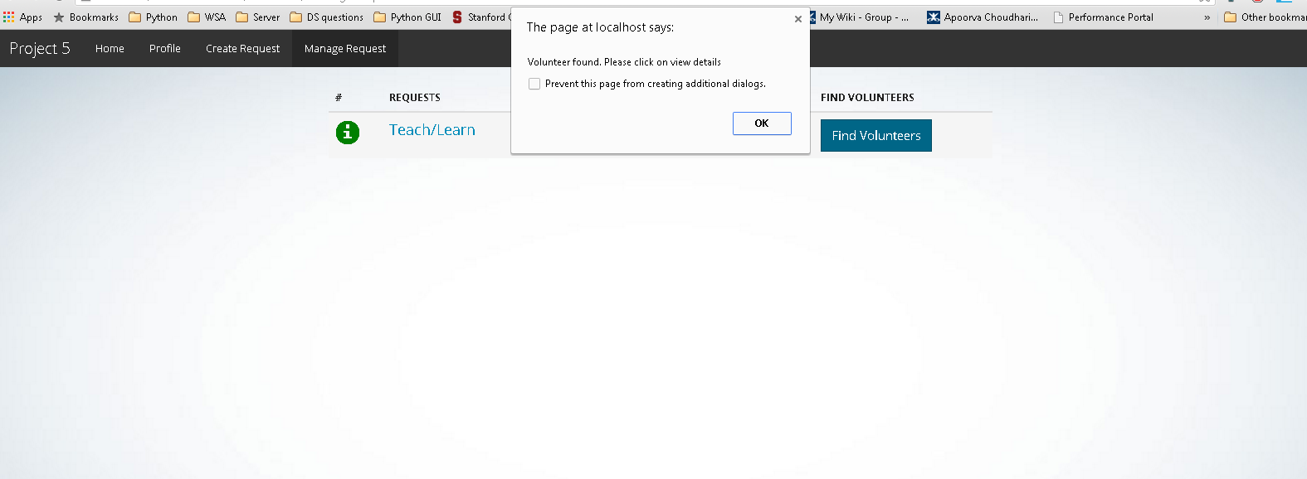
Find Volunteers
When the user clicks on “Find Volunteers”, it tries to find a suitable volunteer for the seeker.

Slide 12
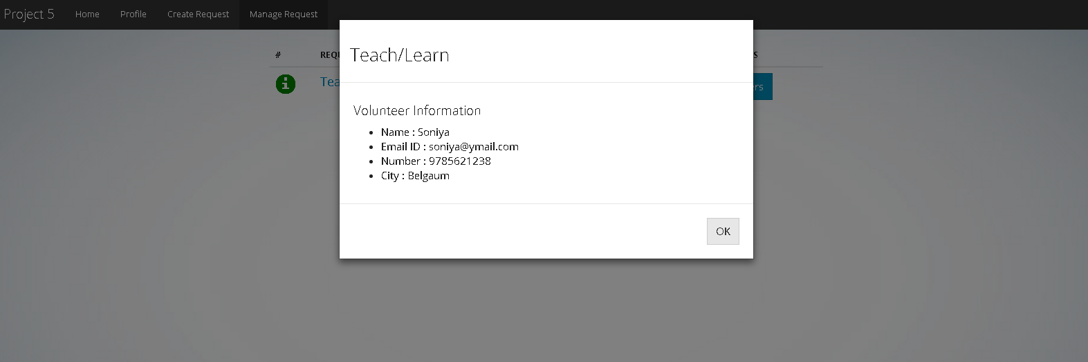
View details
When the user clicks on “View Details”, the volunteer information is displayed.

Slide 13
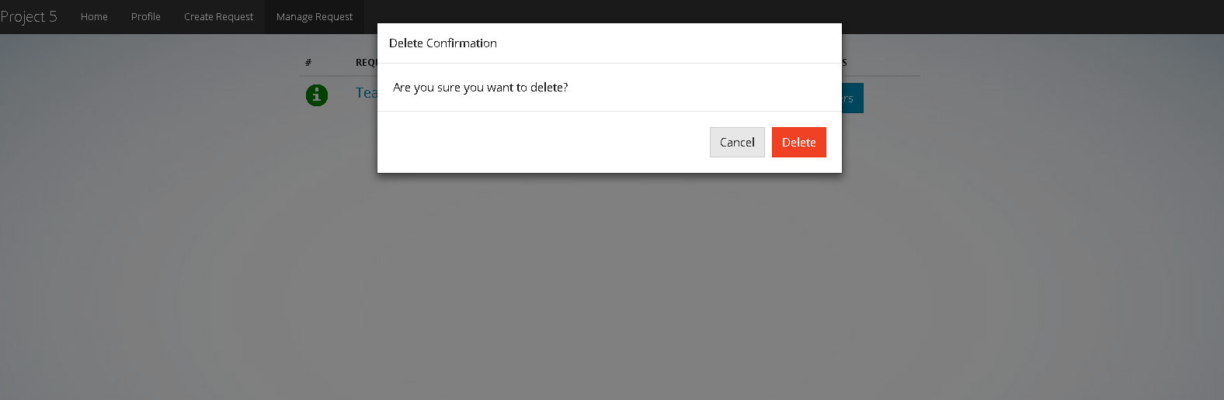
Delete a request

Slide 14
Thank you

